Slide 1
Unit 1.
Fundamentals of metabolism
B.Sc. Sem 5
Dr. Nishant Junnarkar

Slide 2
Contents
Overview of metabolism
Important principles and concepts
ATP the major energy currency of cells
Redox reactions
Electron transport chain

Slide 3
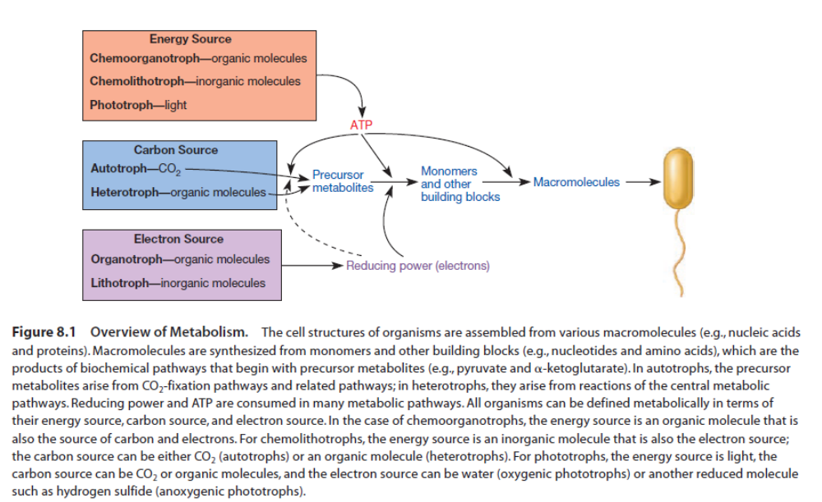
Overview of metabolism

Slide 4
Important principles and concepts
Bioenergetics
Laws of thermodynamics
  1st law of thermodynamics: states that energy can neither be created nor destroyed, but can be converted into other forms of energy or used to perform work.
  2nd law of thermodynamics: states that the entropy, or degree of disorder, of the universe is always increasing.
Energy expression:
  Calorie (cal)
  Joule (J)
1 Joule = 4.184 calories

Slide 5
Features common to all types of metabolism
Life obeys the laws of thermodynamics. Therefore to maintain their structural complexity, organisms must obtain energy from their environment.
• The energy cells obtain from their environment is most often conserved as a molecule called ATP. ATP is used to supply the energy needed for certain chemical reactions to proceed.
• Oxidation-reduction (redox) reactions play a critical role in energy conservation. Many of these redox reactions occur in electron transport chains.

Slide 6
• The chemical reactions that occur in cells are organized into pathways. Thus the product of one reaction is the substrate for the next reaction in the pathway.
• Each reaction of a pathway is catalyzed by an enzyme or a ribozyme. Enzymes and ribozymes are critical to all life as they speed up the reactions that enable life to exist.
• The functioning of biochemical pathways is regulated so that their products are made at the correct time.

Slide 7
Cellular work and energy transfer
Cells carry out three major types of work
  Chemical work
  Transport work
  Mechanical work

Slide 8
Chemical work involves the synthesis of complex biological molecules from much simpler precursors (i.e., anabolism); energy is needed to increase the molecular complexity of a cell.
Transport work requires energy to take up nutrients, eliminate wastes, and maintain ion balances. Energy input is needed because molecules and ions often must be transported across cell membranes against an electrochemical gradient.
Mechanical work: Energy is required for cell motility and the movement of structures within cells, such as partitioning chromosomes during cell division.

Slide 9
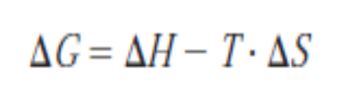
Free energy and reactions
∆G is the change in free energy, ΔH is the change in enthalpy, T is the temperature in Kelvin (°C 273), and ΔS is the change in entropy occurring during the reaction.
The change in enthalpy is the change in heat content. Cellular reactions occur under conditions of constant pressure and volume. Thus the change in enthalpy is about the same as the change in total energy during the reaction.
The free energy change is the amount of energy in a system (or cell) available to do useful work at constant temperature and pressure.
Therefore the change in entropy (ΔS) is a measure of the proportion of the total energy change that the system cannot use in performing work.

Slide 10
A reaction will occur spontaneously if the free energy of the system decreases during the reaction or, in other words, if ΔG is negative.
It follows from the equation that a reaction with a large positive change in entropy will normally tend to have a negative ΔG value and therefore occur spontaneously.
A decrease in entropy will tend to make ΔG more positive and the reaction less favorable.

Slide 11
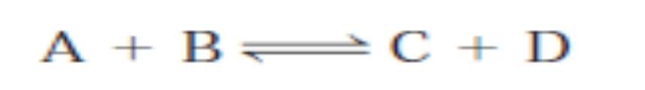
The change in free energy has a definite, concrete relationship to the direction of chemical reactions.
Consider this simple reaction.
If the molecules A and B are mixed, they will combine to form the products C and D.
Eventually C and D will become concentrated enough to combine and produce A and B at the same rate as C and D are formed from A and B.

Slide 12
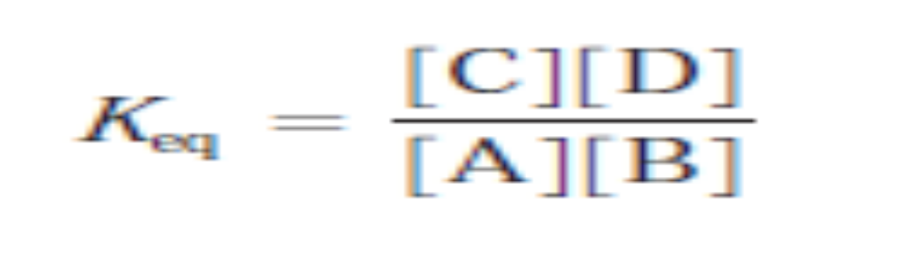
The reaction is now at equilibrium: the rates in both directions are equal and no further net change occurs in the concentrations of reactants and products.
This situation is described by the equilibrium constant (Keq), relating the equilibrium concentrations of products and substrates to one another.

Slide 13
Standard Free Energy Change (ΔG°)
The equilibrium constant of a reaction is directly related to its change in free energy.
When the free energy change for a process is determined at carefully defined standard conditions of concentration, pressure, pH, and temperature, it is called the standard free energy change (ΔG°).
If the pH is set at 7.0 (which is close to the pH of living cells), the standard free energy change is indicated by the symbol ΔG°′.
The change in standard free energy may be thought of as the maximum amount of energy available from the system for useful work under standard conditions.

Slide 14
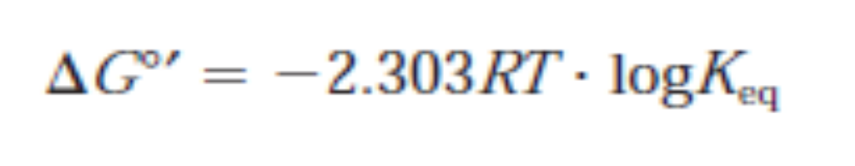
Using ∆G°′ values allows one to compare reactions without worrying about variations in the ∆G due to differences in environmental conditions.
The relationship between ∆G°′ and Keq is given by this equation.

Slide 15
Exergonic and Endergonic reactions
Reactions that have a negative ∆G release free energy and are called exergonic reactions.
A negative ∆G means that the reactants, or initial state, have more free energy than the products, or final state.
Exergonic reactions are also called spontaneous reactions, because they can occur without the addition of energy.

Slide 16
Reactions which have a positive ∆G (∆G > 0) are endergonic in nature and require an input of energy and are called endergonic reactions.
Reactions with in nature.
Endergonic reactions are non-spontaneous, meaning that energy must be added before they can proceed.

Slide 17
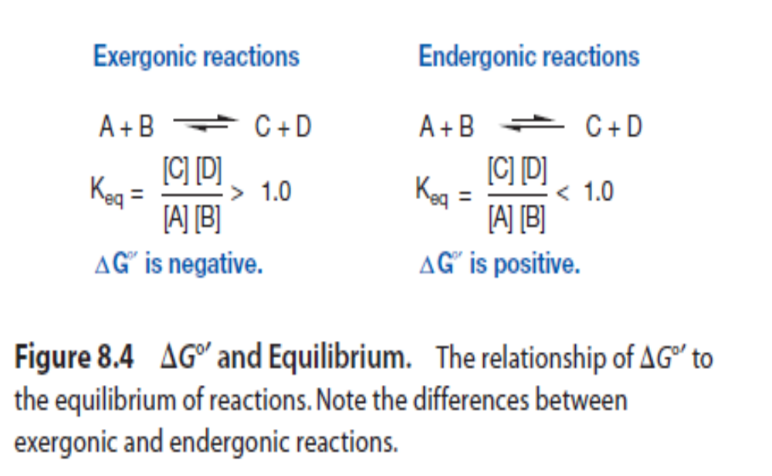

Slide 18
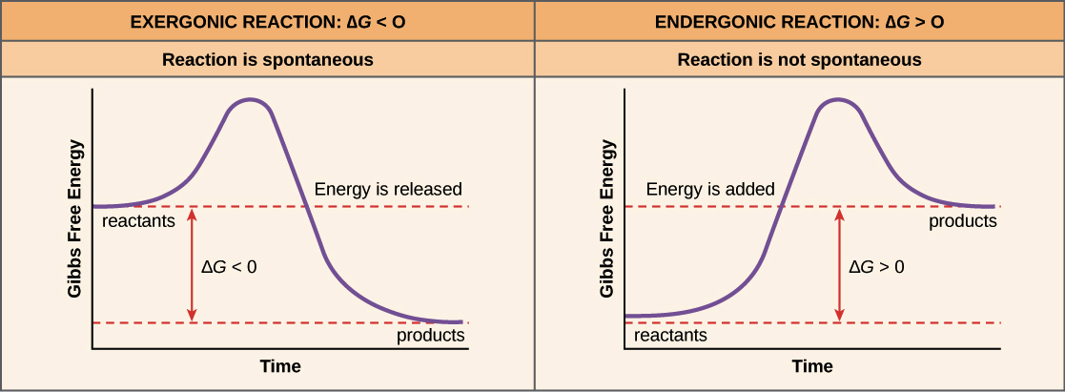

Slide 19
Redox Reactions and Standard reduction potential (E₀)
Free energy changes are related to the equilibria of all chemical reactions including the equilibria of oxidation-reduction reactions.
The release of energy from an energy source normally involves oxidation-reduction reactions.
Oxidation-reduction (redox) reactions are those in which electrons move from an electron donor to an electron acceptor.
By convention such a reaction is written with the donor to the right of the acceptor and the number (n) of electrons (e-) transferred.

Slide 20

The acceptor and donor pair is referred to as a redox couple.
The equilibrium constant for the reaction is called the standard reduction potential (E₀) and is a measure of the tendency of the donor to lose electrons.
The reference standard for reduction potentials is the hydrogen system with an E′₀ (the reduction potential at pH 7.0) of 0.42 volts or 420 millivolts.

Slide 21
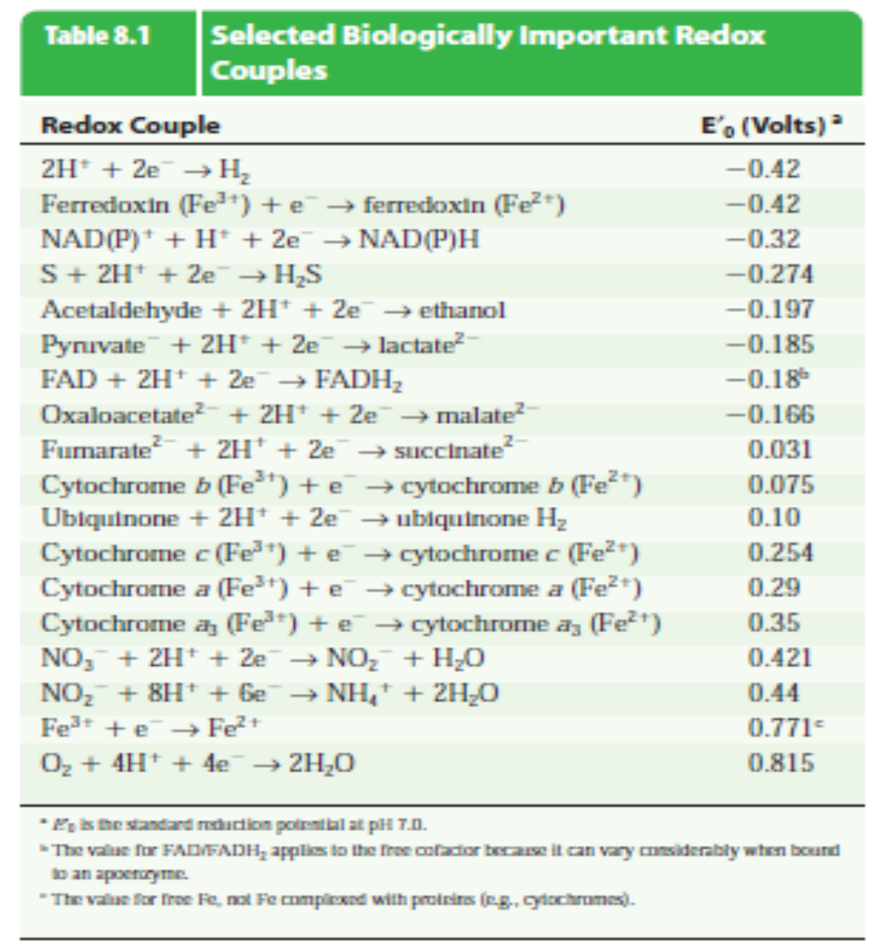

Slide 22
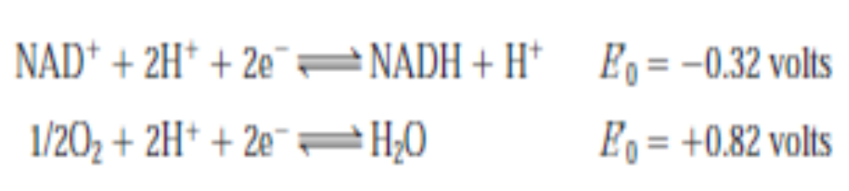
Electrons move from donors to acceptors down the potential gradient or fall down the tower to more positive potentials.
Consider the case of the electron carrier nicotinamide adenine dinucleotide (NAD).
The NAD/NADH couple has a very negative E′0 and can therefore give electrons to many acceptors, including O₂.

Slide 23
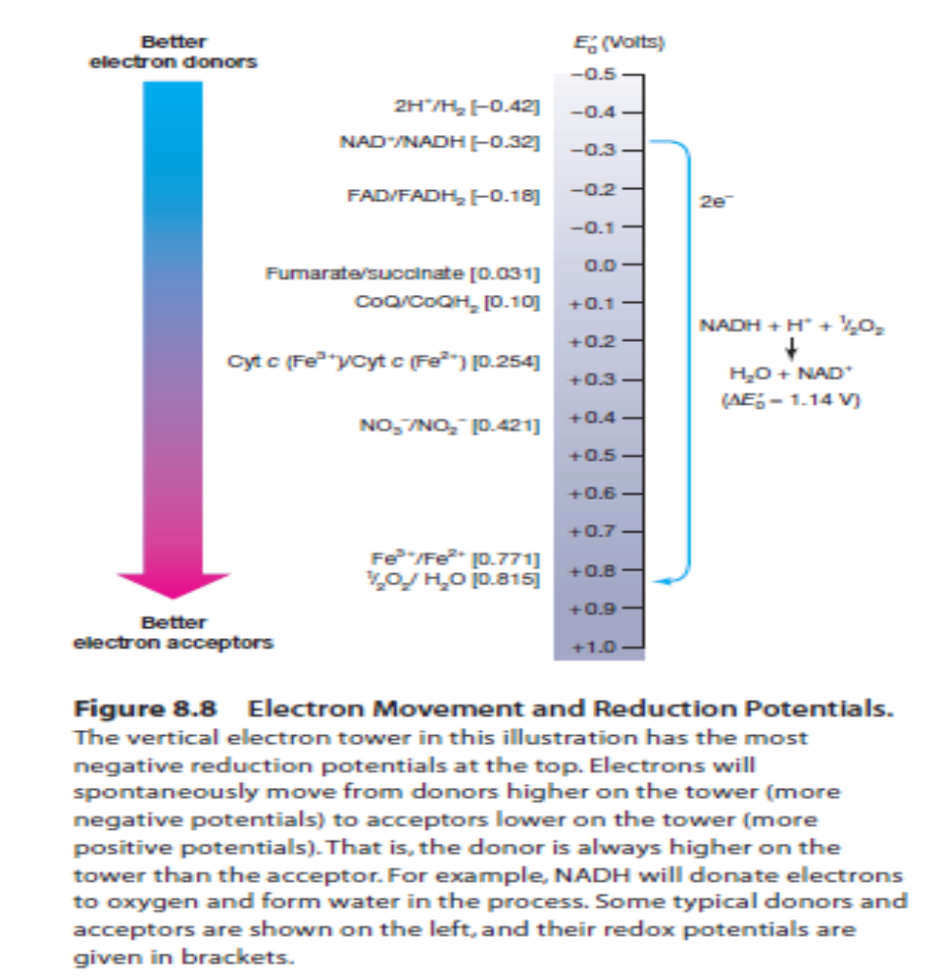

Slide 24
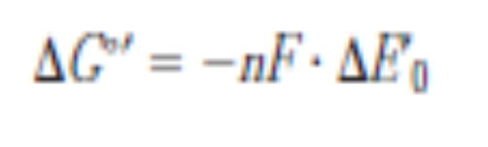
It follows that when electrons move from a donor to an acceptor with a more positive redox potential free energy is released.
The G°′ of the reaction is directly related to the magnitude of the difference between the reduction potentials of the two couples (ΔE′0).
The larger the ΔE′₀, the greater the amount of free energy made available, as is evident from the equation

Slide 25
in which n is the number of electrons transferred and F is the Faraday constant (23,062 cal/mole-volt or 96,494 J/mole-volt).
For every 0.1 volt change in ΔE′₀, there is a corresponding 4.6 kcal change in ΔG°′ when a two-electron transfer takes place.
This is similar to the relationship of ΔG°′ and Keq in other chemical reactions—the larger the equilibrium constant, the greater the ΔG°′.
The difference in reduction potentials between NAD/NADH and 1/2O₂/H₂O is 1.14 volts, a large ΔE′₀ value.
When electrons move from NADH to O₂, a large amount of free energy is made available to synthesize ATP

Slide 26
Electron Transport chain and ATP synthesis
Dr. Nishant Junnarkar

Slide 27
Electron transport chain
Many of the electrons released from glucose are accepted by NAD, which is then reduced to NADH.
NADH next transfers the electrons toO₂. However, it does not do so directly.
Instead, the electrons are transferred to O₂ via a series of electron carriers.
The electron carriers are organized into a system called an electron transport system (ETS) or electron transport chain (ETC).
The carriers are organized such that the first electron carrier has the most negative E′₀, and each successive carrier is slightly less negative

Slide 28
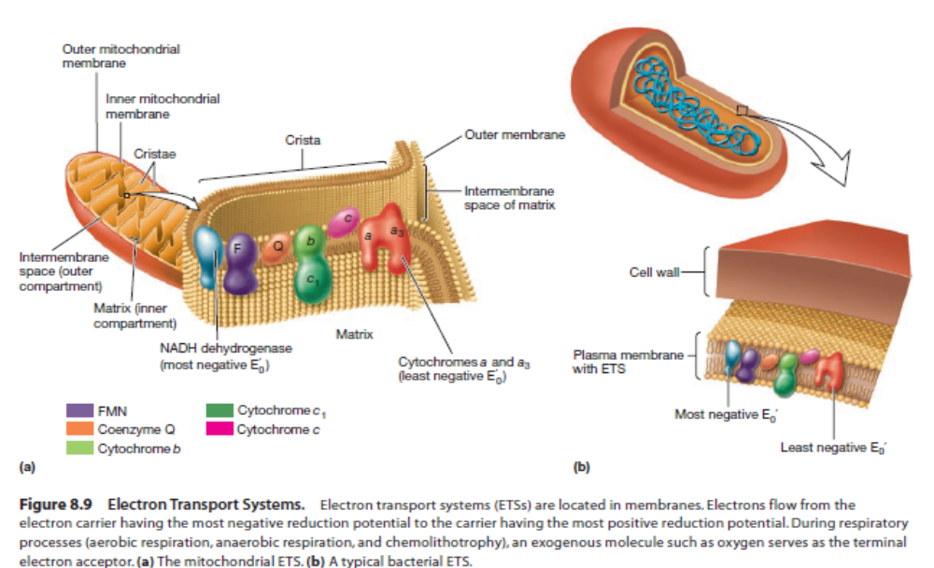

Slide 29
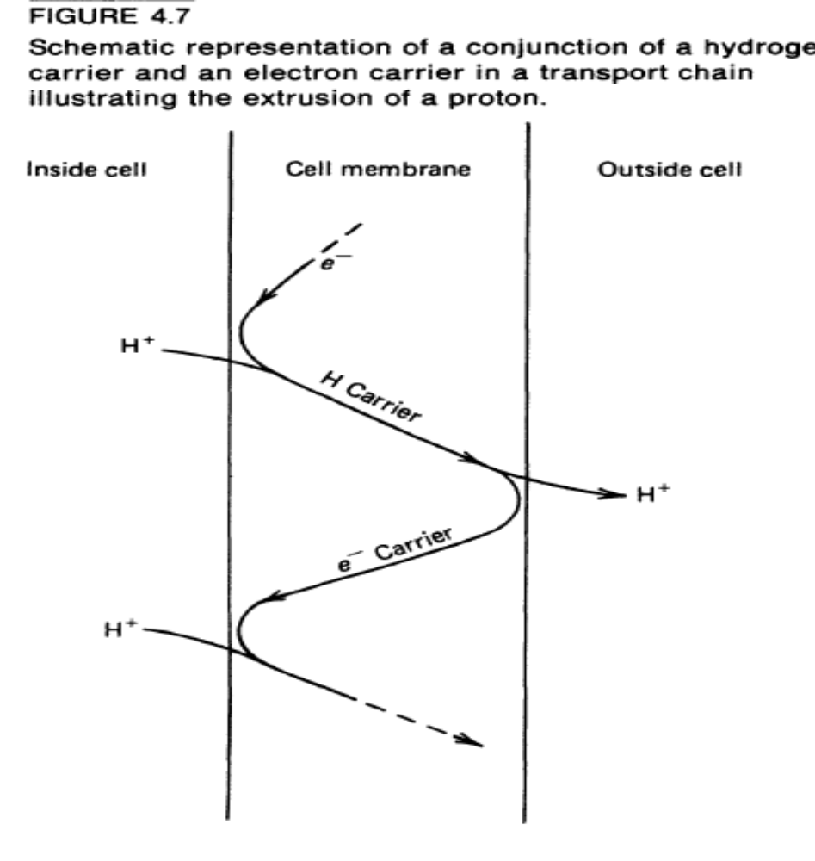

Slide 30
Carriers of Electron Transport Chain
The carriers that make up ETSs differ in terms of their chemical nature and the way they carry electrons.

Slide 31
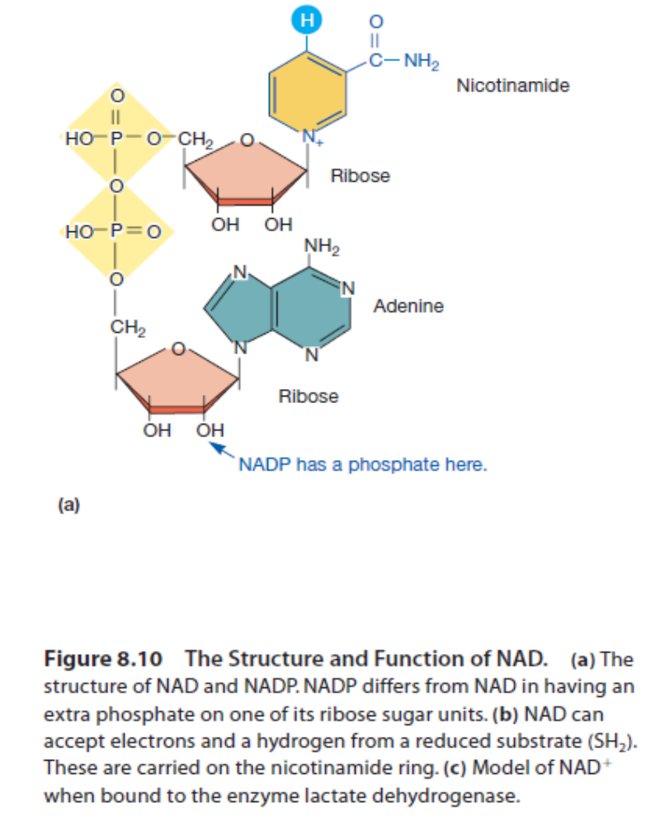
NAD and NADP
NAD, and its chemical relative nicotinamide adenine dinucleotide phosphate (NADP), contain a nicotinamide ring (figure 8.10).
This ring accepts two electrons and one proton from a donor (e.g., an intermediate formed during the catabolism of glucose), and a second proton is released.

Slide 32
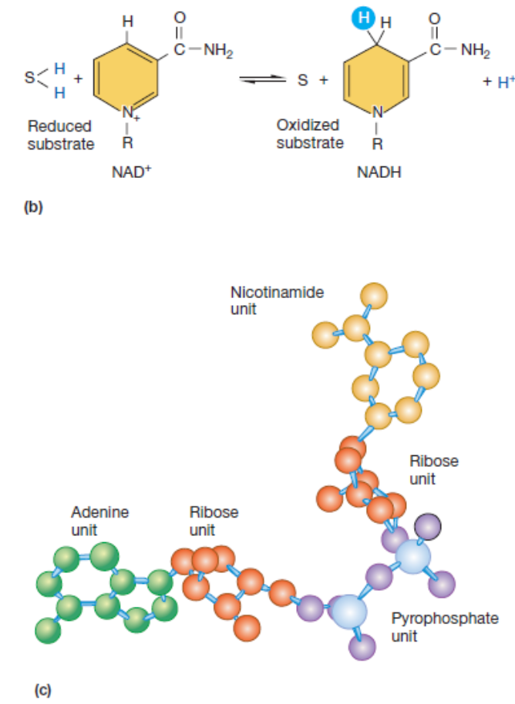

Slide 33
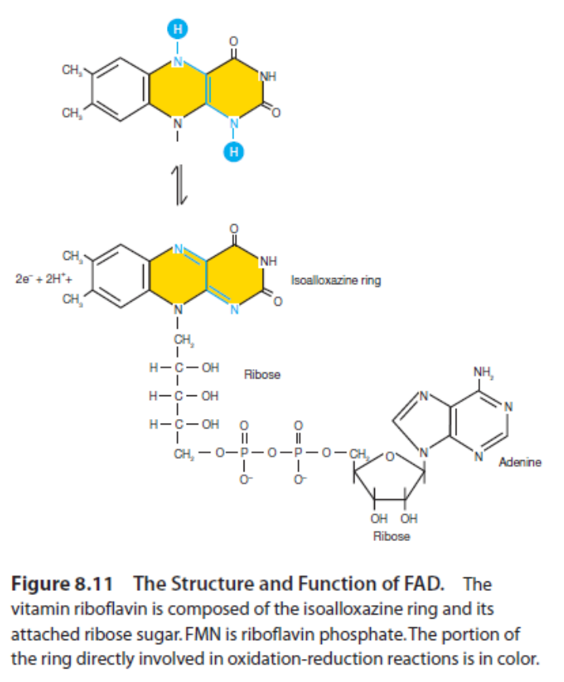
FAD/FMN
Flavin adenine dinucleotide (FAD) and flavin mononucleotide (FMN) bear two electrons and two protons on the complex ring system shown in figure 8.11.
Proteins bearing FAD and FMN are often called flavoproteins.

Slide 34
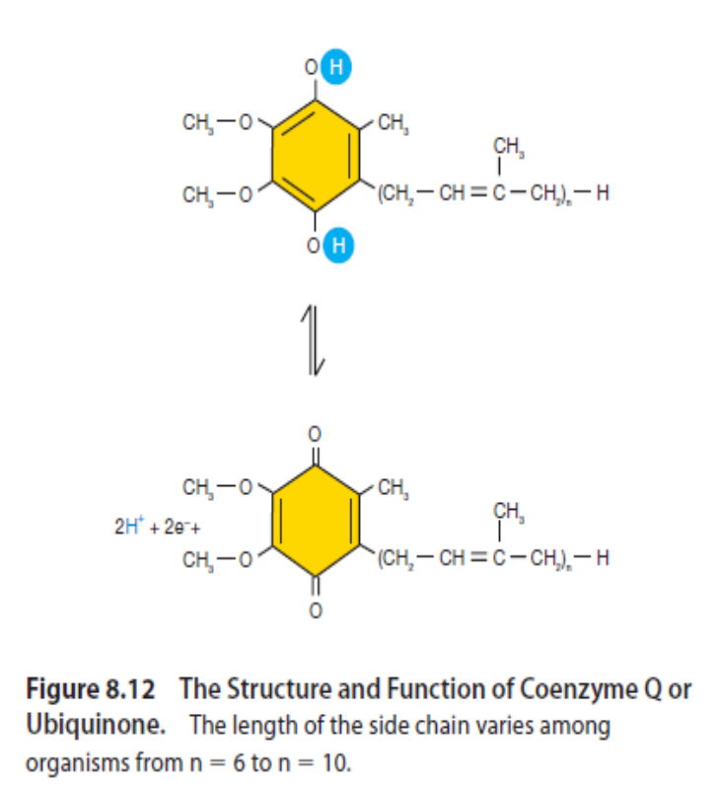
Coenzyme Q
Coenzyme Q (CoQ) or ubiquinone is a quinone that transports two electrons and two protons in many electron transport chains

Slide 35
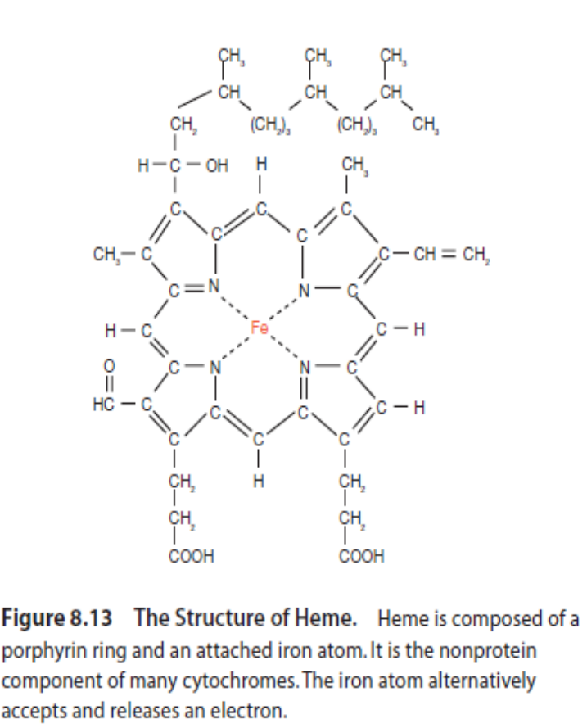
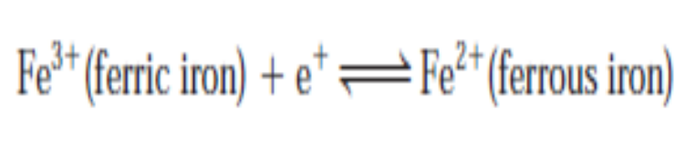
Cytochromes
Cytochromes and several other carriers use iron atoms to transport electrons one electron at a time by reversible oxidation and reduction reactions.
In the cytochromes these iron atoms are part of a heme group (figure 8.13) or other similar iron-porphyrin rings.

Slide 36
Table: Cytochromes of aerobic ETC
Cytochromes | Prosthetic group (number) | Mol. Wt. | E’₀ value (V)
a₁ | 2 heme a |  | +0.14 and +0.25
aa₃ | heme a | 73000 | +0.20 to +0.27 and +0.36 to +0.38
b | heme b | 12000 to 17500 | -0.11 to +0.11
c | heme c | 12000 to 100,000 | +0.19 to +0.34
d | 2 heme d 2 heme b | 350000 | +0.28 +0.14 and +0.26
o | 2 heme b | 28000 | _0.12 to +0.42

Slide 37
Cytochrome composition of bacteria is variable among species and environments.
For eg. An aerobically grown culture will have a different cytochrome composition from that of the same strain grown anaerobically or even grown with a restricted supply of oxygen.

Slide 38
Non-heme Fe-S proteins: eg. Ferredoxin
Several different cytochromes, each of which consists of a protein and an iron porphyrin ring, are a prominent part of electron transport chains.
Some iron containing electron-carrying proteins lack a heme group and are called nonheme iron proteins.
They are often referred to as iron-sulfur (Fe-S) proteins because the iron is associated with sulfur atoms.

Slide 39
Ferredoxin
Ferredoxin is a non-heme iron protein active in photosynthetic electron transport and several other electron transport processes.
Even though its iron atoms are not bound to a heme group, they still undergo reversible oxidation and reduction reactions.
Like cytochromes, they carry only one electron at a time.

Slide 40
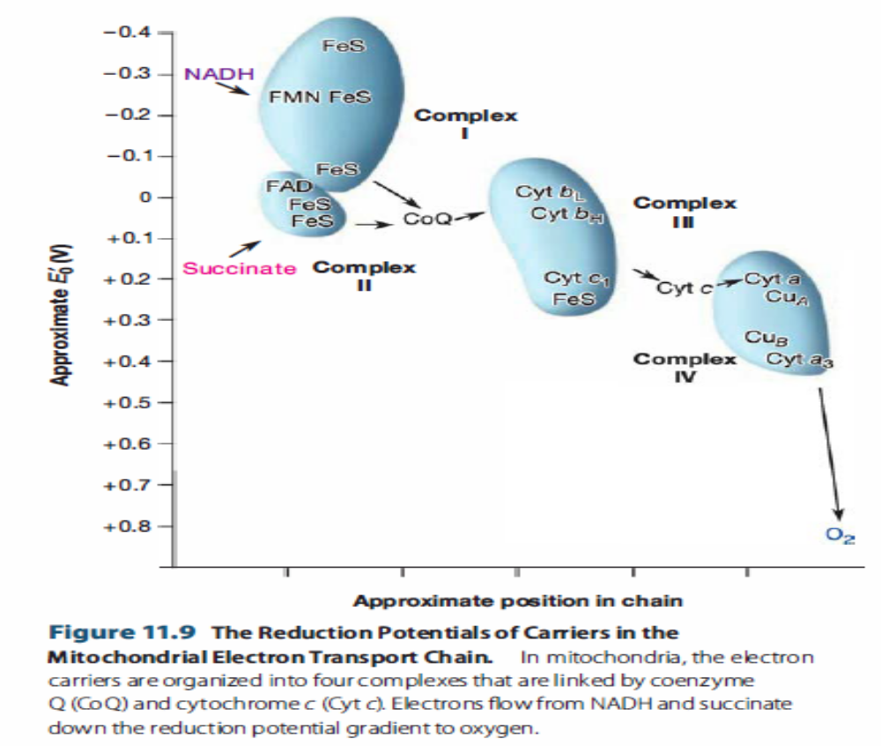
Electron transport chain

Slide 41
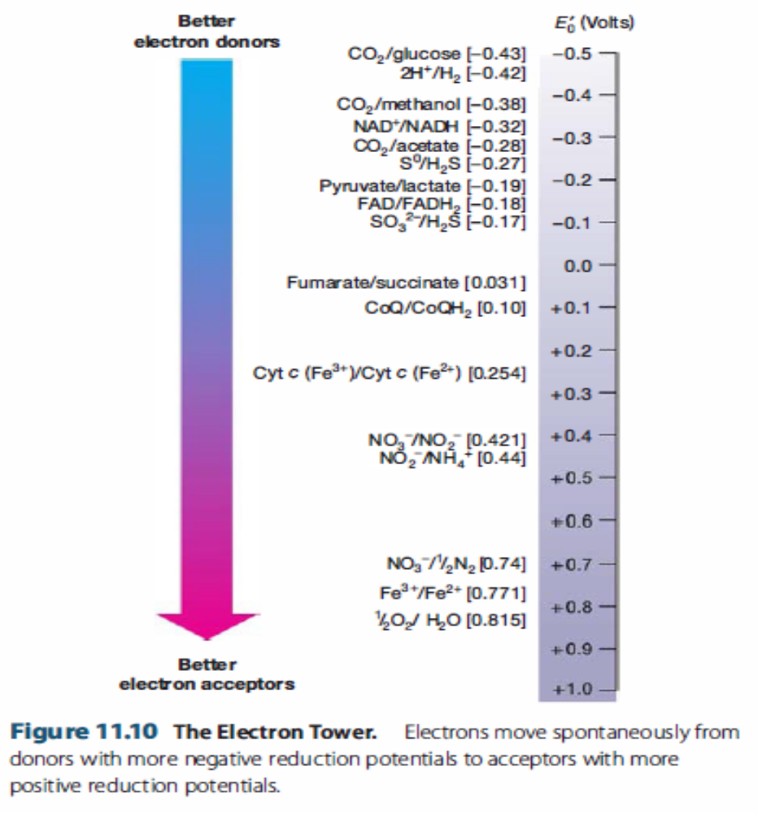

Slide 42
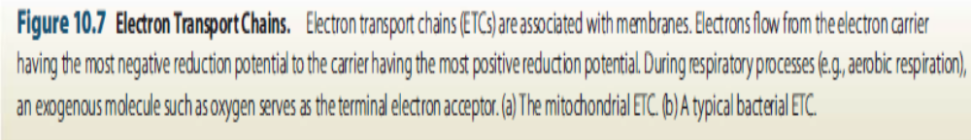
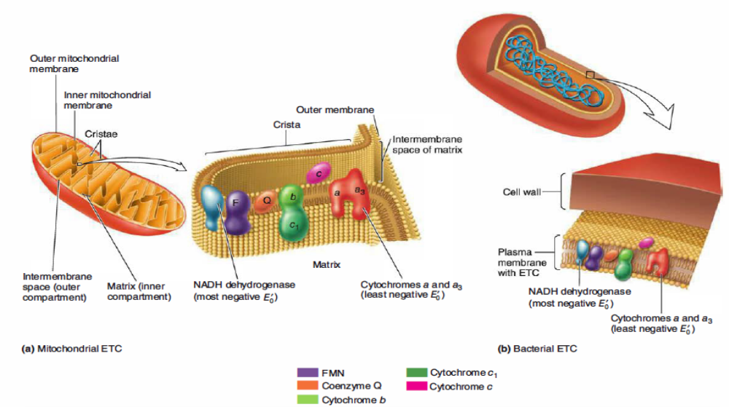

Slide 43
Inhibitors of ETC
Several site-specific inhibitors are identified.
These compounds prevent the passage of electrons by binding to a component of the chain, blocking the oxiation/reduction reaction.

Slide 44
Rotenone, a plant product, inhibits the transfer of electrons through the NADH-CoQ reductase complex. It is used as a fish poison and as a insecticide.
NADH → UQ → Cytb → Cyt c₁ → Cyt c → Cyt (a + a₃) → O₂
_{Rotenone}

Slide 45
Cyanide, azide and CO binds with cytochrome oxidase complex and inhibits the terminal transfer of electron to O_{2.}
Cyanide and azide react with the oxidized form of the cytochrome and CO reacts with the reduced form.
NADH → UQ → Cytb → Cyt c₁ → Cyt c → Cyt (a + a₃) → O₂

Slide 46
Plants also have alternative mechanisms for oxidizing NADH.
Electrons from NADH directly transfer to ubiquinone and from ubiquinone directly to O₂ , bypassing Complexes III and IV.
Hence, NADH oxidation by this pathway is Cyanide resistant.

Slide 47
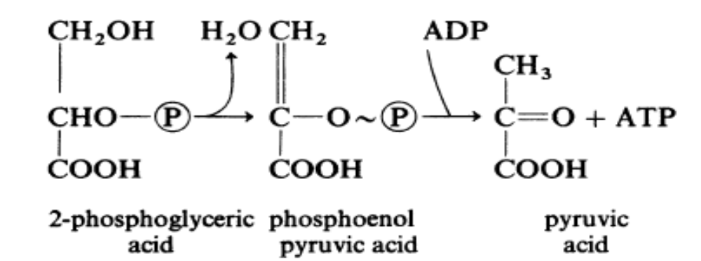
Biochemical mechanisms generating ATP
Substrate level Phosphorylation

Slide 48
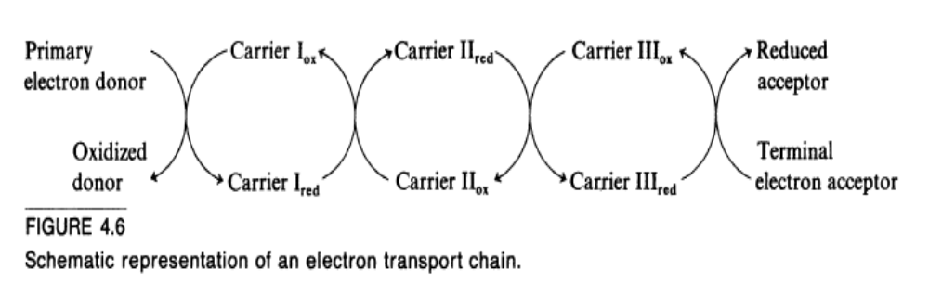
Generation of ATP by Electron transport chain
In respiration and photosynthesis
e- passes through several electron carrier and finally accepted by terminal e- acceptor

Slide 49
e- carriers and H-carriers
Orientation of H-carriers in cell membrane is such that they transport in the direction towards outside the cell and orientation of e- carriers is such that they transport towards inside the cell.

Slide 50
Proton motive force : pmf
The cell membrane is otherwise impermeable to protons; as a consequence, electron transport traps a portion of the chemical energy released by the net reaction of the chain (oxidation of the primary electron donor by the terminal electron acceptor) in the form of a gradient across the membrane of protons and electrical charge.

Slide 51
Such a gradient, termed a protonmotive force (Δp) is a form of potential energy capable of doing work:
it drives certain permease systems that concentrate externally supplied substrates within the cell;
it provides the energy for flagellar-mediated cell motility and
it drives the energy-requiring synthesis of ATP from ADP

Slide 52
Synthesis of ATP by pmf
The synthesis of ATP at the expense of protonmotive force is catalysed by a complex membrane-bound enzyme, ATP phosphohydrolase (sometimes termed ATPase or ATP synthase)
ATPase is composed, of two multicomponent proteins F0 and F1 (BF0 and BF1 respectively in bacteria).

Slide 53
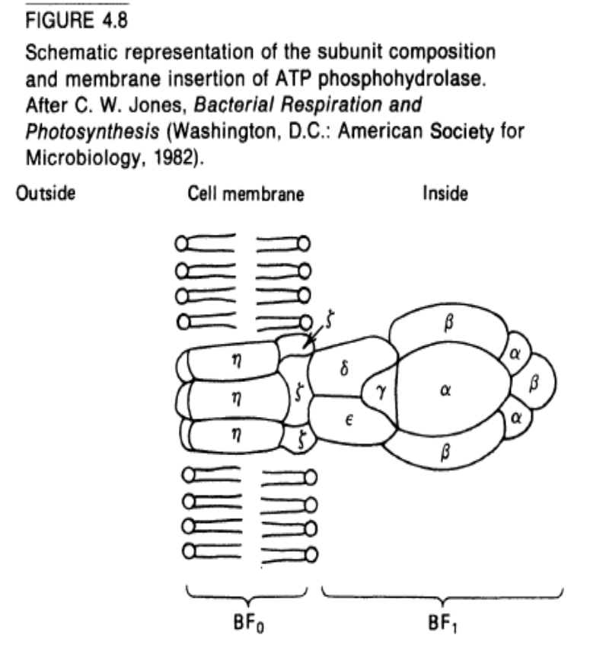
The α and β subunits of BF 1 are arranged alternately to form a hollow hexagon, the central hole of which contains the γ subunit associated with other subunits δ and ε.
Thus BF 1 probably has the subunit structure α₃β₃γ δε. The α and β subunits form the catalytically active portion of the structure, the site where ATP is synthesized from ADP and inorganic phosphate;
the γ, δ and ε subunits form a proton-translocating stalk and gate that bring to the active site at the proper rate the protons that drive the reaction.

Slide 54
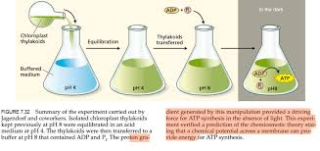
ATP synthesis occurs through chemiosmotic mechanism.

Slide 55
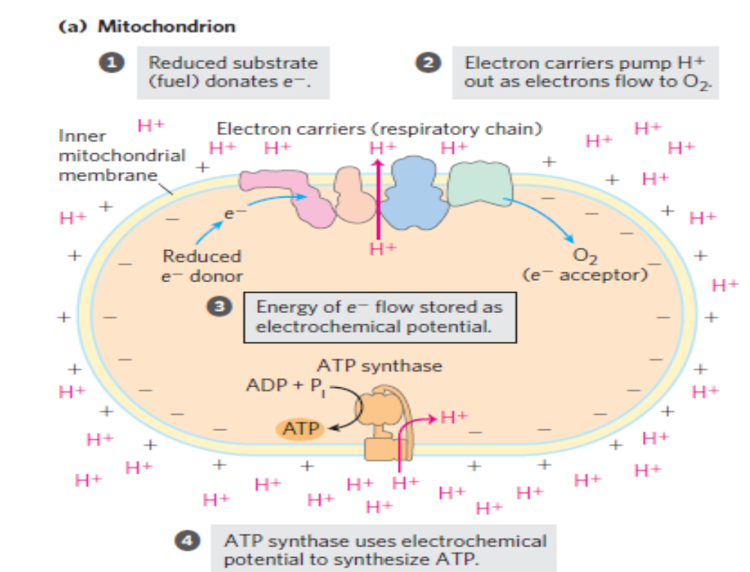

Slide 56
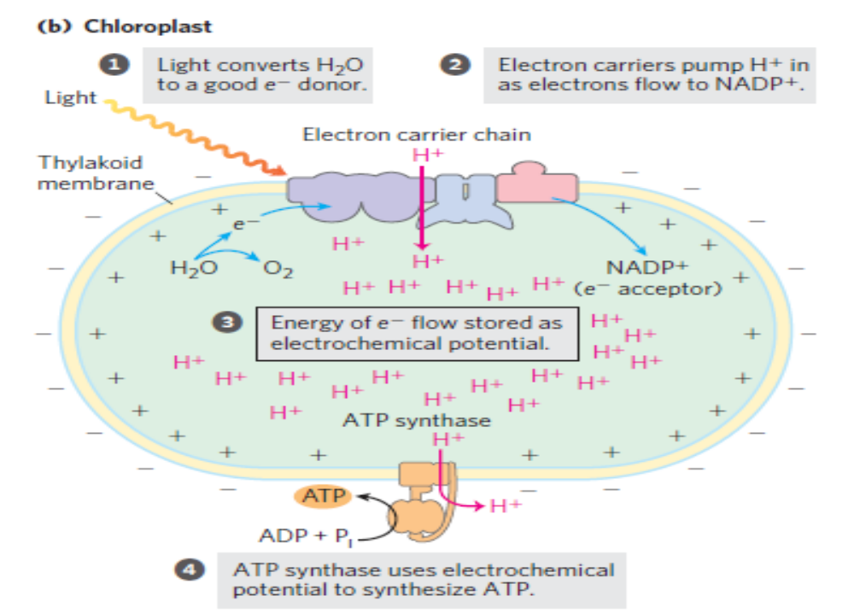

Slide 57
Thank you

