Slide 1

Operational Amplifier Applications
By
Dr.Vikash Kumar
DEPARTMENT OF PHYSICS(ELECTRONICS)

Slide 2
Operational Amplifier Applications
An Operational Amplifier, or op-amp for short, is fundamentally a voltage amplifying device designed to be used with external feedback components such as resistors and capacitors between its output and input terminals. These feedback components determine the resulting function or “operation” of the amplifier and by virtue of the
different feedback configurations whether resistive, capacitive or both, the amplifier can perform a variety of different operations, giving rise to its name of “Operational Amplifier”.
In a linear operational amplifier, the output signal is the amplification factor, known as the amplifiers gain ( A ) multiplied by the value of the input signal and depending on the nature of these input and output signals, there can be four different classifications of operational amplifier gain.
Voltage – Voltage “in” and Voltage “out”
Current – Current “in” and Current “out”
Trans-conductance – Voltage “in” and Current “out”
Trans-resistance – Current “in” and Voltage “out”
As we shall see, op-amp has countless applications and forms the basic building block of linear and non-linear analog system. In linear circuits, the output signal varies with the input signal in a linear manner. Linear application are:-
Adder, Sub-tractor, voltage to current converter and current to voltage converter, instrumentation amplifier, analog computation, power amplifier etc.

Slide 3
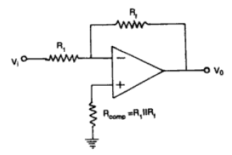
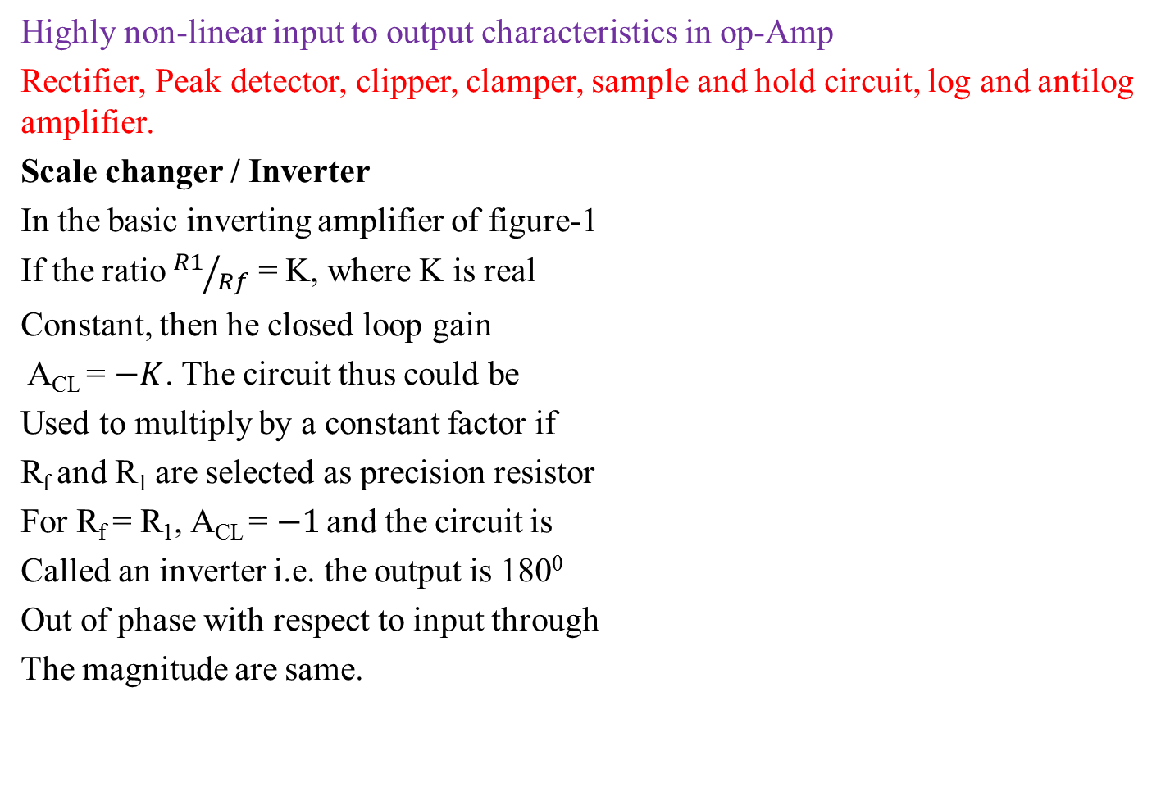
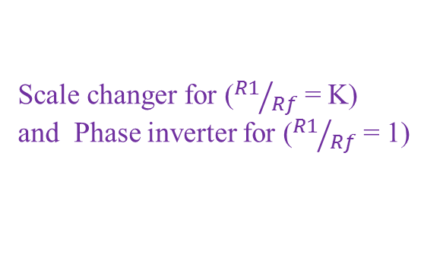
Highly non-linear input to output characteristics in op-Amp
Rectifier, Peak detector, clipper, clamper, sample and hold circuit, log and antilog amplifier.
Scale changer / Inverter
In the basic inverting amplifier of figure-1
If the ratio ${R1}/{Rf}$ = K, where K is real
Constant, then he closed loop gain
A_{CL} = $−K$. The circuit thus could be
Used to multiply by a constant factor if
R_{f} and R₁ are selected as precision resistor
For R_{f} = R₁, A_{CL} = $−1$ and the circuit is
Called an inverter i.e. the output is 180⁰
Out of phase with respect to input through
The magnitude are same.
R_{f}
R₁
R_{comp} = R₁|| R_{f}
Fig-1
Scale changer for (${R1}/{Rf}$ = K)
and Phase inverter for (${R1}/{Rf}$ = 1)

Slide 4
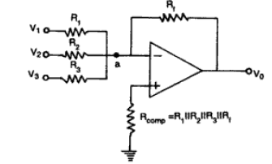
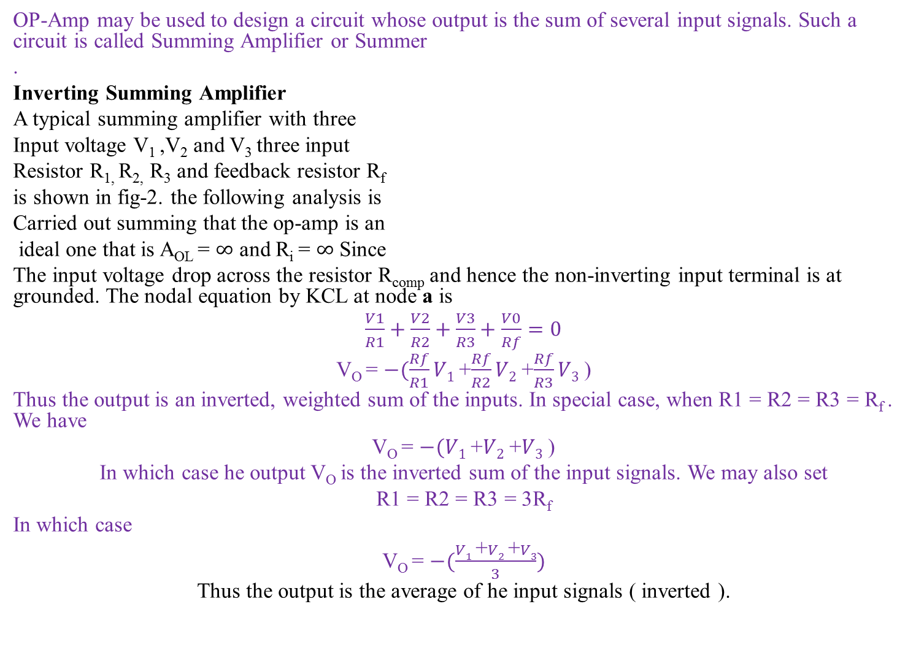
Summing Amplifier
OP-Amp may be used to design a circuit whose output is the sum of several input signals. Such a circuit is called Summing Amplifier or Summer
.
Inverting Summing Amplifier
A typical summing amplifier with three
Input voltage V₁ ,V₂ and V₃ three input
Resistor R_{1,} R_{2,} R₃ and feedback resistor R_{f}
is shown in fig-2. the following analysis is
Carried out summing that the op-amp is an
ideal one that is A_{OL} = $∞$ and R_{i} = $∞$ Since
The input voltage drop across the resistor R_{comp} and hence the non-inverting input terminal is at grounded. The nodal equation by KCL at node a is
$\frac{V1}{R1}+$ $\frac{V2}{R2}+$ $\frac{V3}{R3}+$ $\frac{V0}{Rf}=0$
V_{O} = $−(\frac{Rf}{R1}V1$+$\frac{Rf}{R2}V2$+$\frac{Rf}{R3}V3$)
Thus the output is an inverted, weighted sum of the inputs. In special case, when R1 = R2 = R3 = R_{f} . We have
V_{O} = $−(V1$+$V2$+$V3$)
In which case he output V_{O} is the inverted sum of the input signals. We may also set
R1 = R2 = R3 = 3R_{f}
In which case
V_{O} = $−(\frac{V1 \text{+}V2 \text{+}V3}{3})$
Thus the output is the average of he input signals ( inverted ).
Fig-2

Slide 5
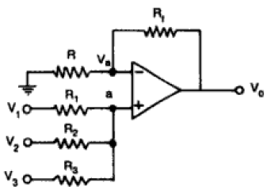
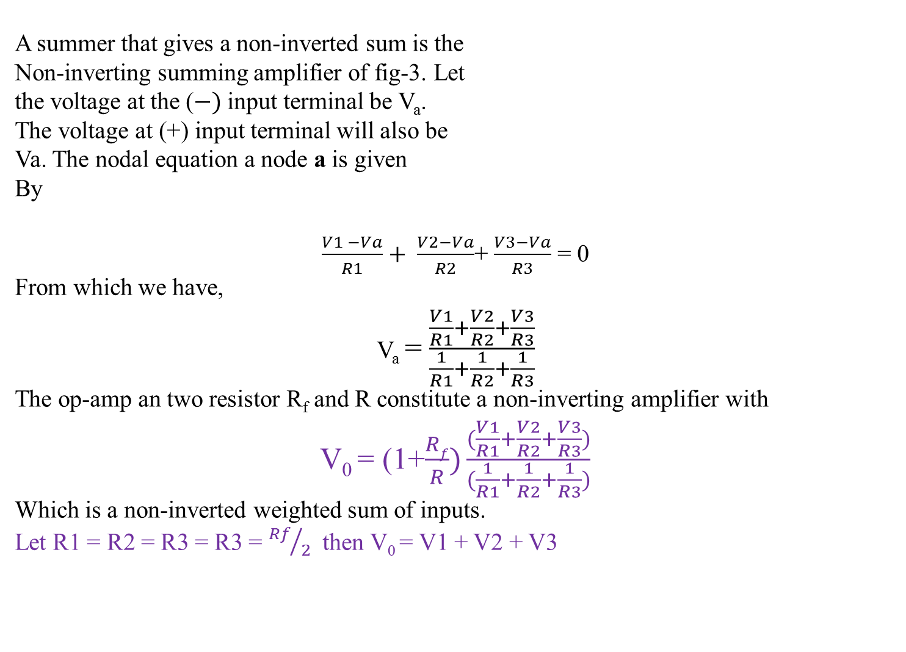
A summer that gives a non-inverted sum is the
Non-inverting summing amplifier of fig-3. Let
the voltage at the ($−)$input terminal be V_{a}.
The voltage at (+) input terminal will also be
Va. The nodal equation a node a is given
By
$\frac{V1 −Va}{R1}+ \frac{V2−Va}{R2}$+ $\frac{V3−Va}{R3}$ = 0
From which we have,
V_{a} = $\frac{\frac{V1}{R1}+\frac{V2}{R2}+\frac{V3}{R3}}{\frac{1}{R1}+\frac{1}{R2}+\frac{1}{R3}}$
The op-amp an two resistor R_{f} and R constitute a non-inverting amplifier with
V₀ = (1+$\frac{Rf}{R})\frac{(\frac{V1}{R1}+\frac{V2}{R2}+\frac{V3}{R3})}{(\frac{1}{R1}+\frac{1}{R2}+\frac{1}{R3})}$
Which is a non-inverted weighted sum of inputs.
Let R1 = R2 = R3 = R3 = ${Rf}/2$ then V₀ = V1 + V2 + V3
Non-Inverting Summing Amplifier

